Slide 1
Focal Frequency Loss for Image Reconstruction and Synthesis
Presented by: zoya Shafique
Jiang, L., Dai, B., Wu, W., & Loy, C. C. (2021). Focal frequency loss for image reconstruction and synthesis. In Proceedings of the IEEE/CVF International Conference on Computer Vision (pp. 13919-13929).

Slide 2
Introduction
Main Questions Being Asked:
How can we improve the images generated by GANs and autoencoders?
How can we remove artifacts, make the images clearer, keep fine details, etc.
Task definition:
Image reconstruction: aims to recreate input images
Image synthesis: generate a new image by combining features from multiple input images

Slide 3
Introduction
Where Does the Problem Arise?
There is a gap between the frequency spectra of the real input images and the generated “fake” images
Proposed Solution
Represent both the real and fake images in the frequency domain using a FFT
For each point on the frequency spectrum of the real and fake images, project the points onto a 2D plane using the phase and amplitude
Minimize the distance between the real and fake image points using a weighted distance

Slide 4
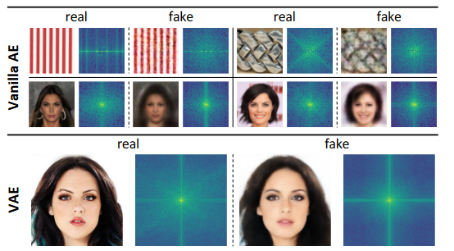
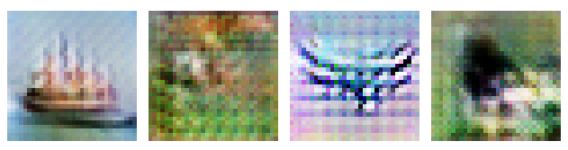
The Gap between Real and Generated Images
Generated images can have artifacts (i.e. checkerboard effect)
Spectral bias: Neural networks learn low-frequencies much better than higher frequencies
F-principle [2]: Neural networks prioritize fitting to low frequencies over high frequencies
[2] Xu, Z. Q. J., Zhang, Y., Luo, T., Xiao, Y., & Ma, Z. (2019). Frequency principle: Fourier analysis sheds light on deep neural networks. arXiv preprint arXiv:1901.06523.

Slide 5
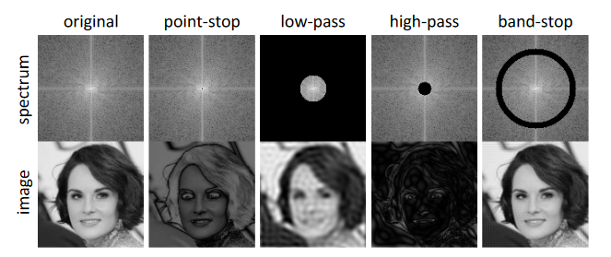
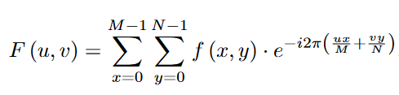


Frequency Representation of Images

Slide 6

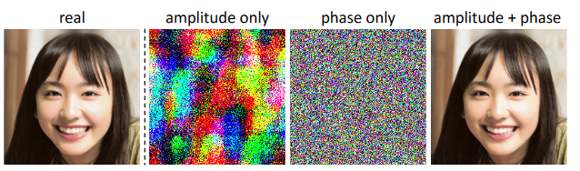

Frequency Representation of Images

Slide 7
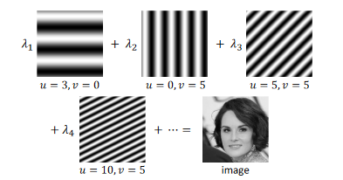
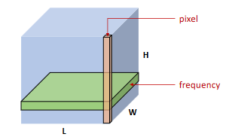
Frequency Representation of Images

Slide 8
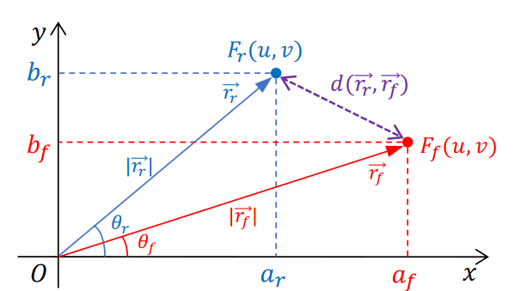


Frequency Distance

Slide 9

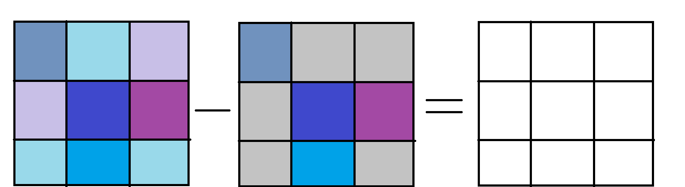

Dynamic Spectral Weighting
Used so that model can focus on hard frequencies
“Spectrum weight matrix” down-weights easy frequencies
α controls how close the weight matric values are
Larger α = more focused on hard frequencies
0
1
1
1
0
0
1
0
1
Notes:
The focal frequency loss can be seen as a weighted average of the frequency distance between the real and fakr images
It helps the model focus on synthesizing the hard frequencies

Slide 10
Experiments: Baselines
Autoencoders
Vanilla AE
Variational Autoencoder
GANS
Pix2pix
SPADE
StyleGAN2
Select five representative methods from two popular categories:
Autoencoder-based networks
GAN-based networks

Slide 11
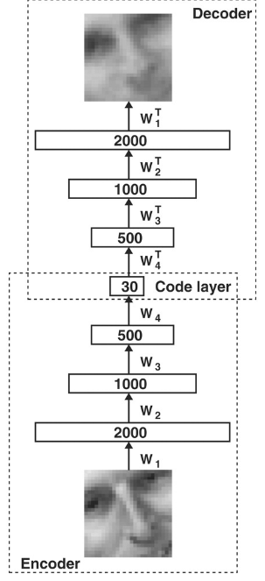
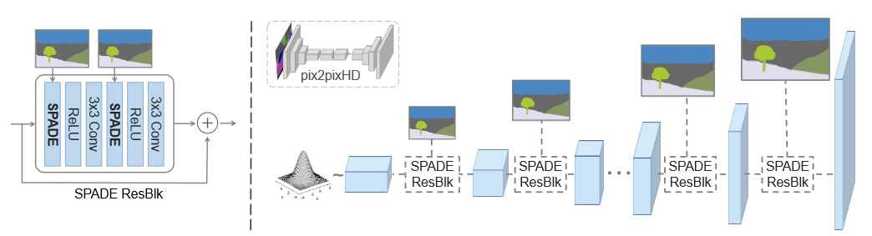
Experiments: Baselines
[3]
Autoencoder
GAN
[4]
[3] Geoffrey E Hinton and Ruslan R Salakhutdinov. Reducing the dimensionality of data with neural networks. Science, 313:504–507, 2006
[4] Taesung Park, Ming-Yu Liu, Ting-Chun Wang, and Jun-Yan Zhu. Semantic image synthesis with spatially-adaptive normalization. In CVPR, 2019

Slide 12
Experiments: Datasets
Describable Textures Dataset (DTD)
Collection of textural images in the wild
Vanilla AE for image reconstruction
CelebA
Large scale face attributes covering large pose variations and background clutter
Vanilla AE and VAE for image reconstruction and synthesis
CelebA-HQ
Higher quality version of CelebA
VAE and Style-GAN2
CMP Facades
Facades are collected from different cities around the world with diverse architectural styles
Pix2pix image-to-image translation
Edges → Shoes
Shoe images and edge maps
Pix2pix image-to-image translation
Cityscapes
Street scene images with 30 classes
SPADE for semantic image synthesis
ADE20K
Challenging in-the-wild images with fine annotations of 150 classes
SPADE for image synthesis

Slide 13

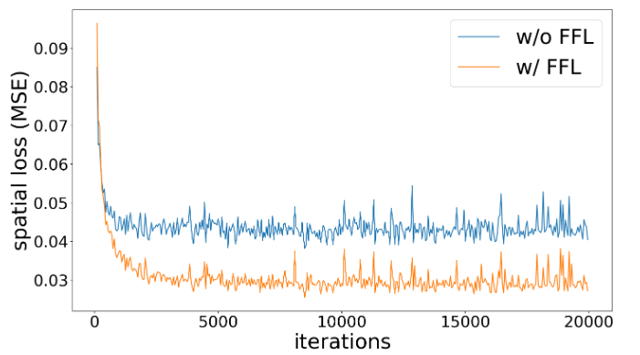
Metrics & Results
Task | Metric | Definition
All tasks | FID LFD | A way to measure the difference between the real and generated images Lower is better
Reconstruction | PSNR SSIM LPIPS | PSNR & SSIM → higher is better LPIPS → lower is better
Synthesis | IS | Higher is better
Semantic Image Synthesis / Segmentation | mIoU Pixel Accuracy
Notes:
We wish to highlight that both the spatial-based loss and frequency-based loss are important since they consider dif- ferent aspects and dimensions of an image, as illustrated in Figure 13. Hence, they are complementary and not re- placeable. The proposed FFL is intending to complement existing spatial losses of different methods to improve re- construction and synthesis quality further.

Slide 14
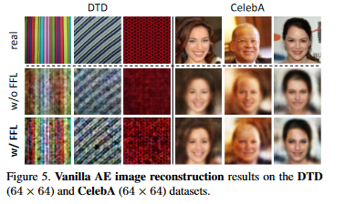
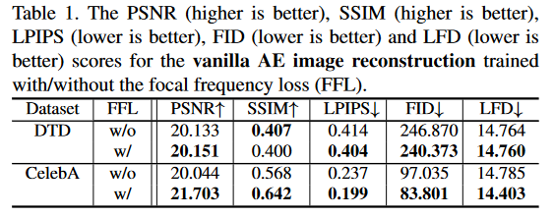
Results

Slide 15
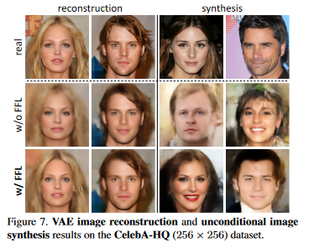
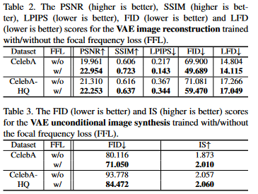
Results

Slide 16
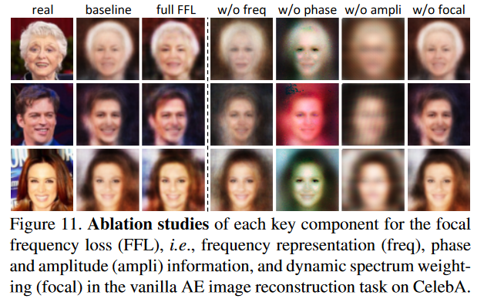
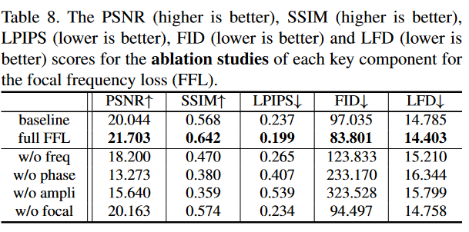
Ablation Studies

Slide 17
Conclusion
Introducing focal frequency loss (FFL) helped boost the performance of existing GAN and autoencoder models for the tasks of image synthesis and image reconstruction
Resulting images had more defined features and, in some cases, reduced blur and artifacts
FFL is used together with spatial loss
Used existing concepts of focal loss and hard example mining to create the FFL

